Slide 1
Query Optimization in DBMS

Slide 2
Techniques used by a DBMS to process high-level queries.
Steps of processing a high level query
A query expressed in a high-level query language such as SQL must first be scanned, parsed, and validated.
The scanner identifies the query tokens—such as SQL keywords, attribute names, and relation names—that appear in the text of the query.
The parser checks the query syntax to determine whether it is formulated according to the syntax rules of the query language.
The query must also be validated by checking that all attribute and relation names are valid and semantically meaningful names in the schema of the particular database being queried.
An internal representation of the query is then created, usually as a tree data structure called a query tree.

Slide 3
Query Optimization
The goal of query optimization is to select the best possible strategy for query evaluation.
Query Trees and Heuristics for Query Optimization
In this section, we discuss optimization techniques that apply heuristic rules to modify the internal representation of a query which is usually in the form of a query tree.
A query has many possible execution strategies, and the process of choosing a suitable one for processing a query is known as query optimization.

Slide 4
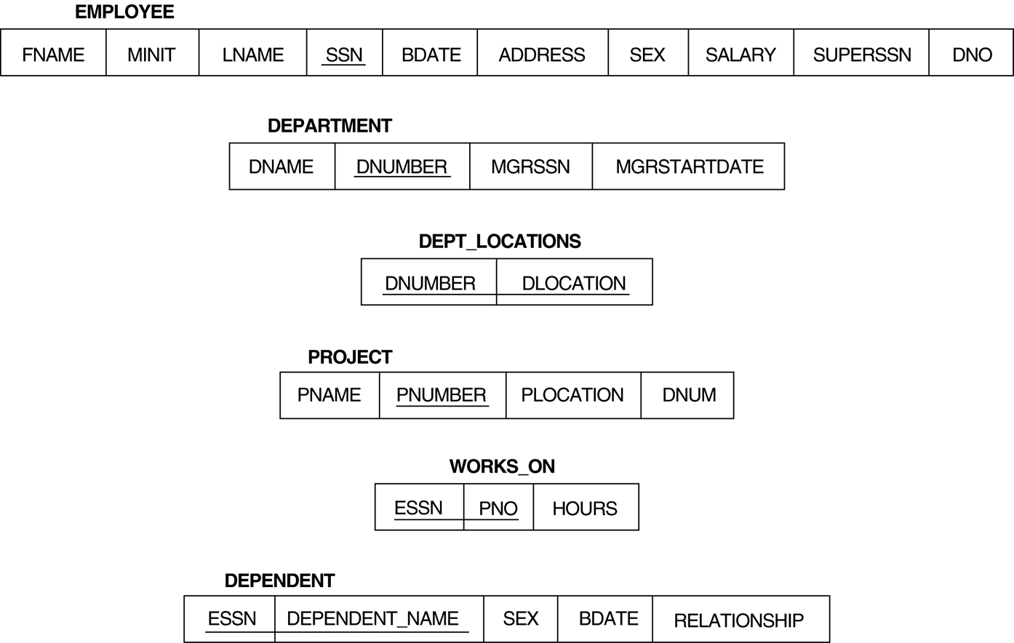

Slide 5
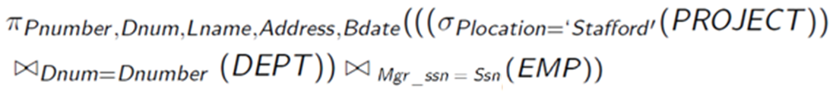
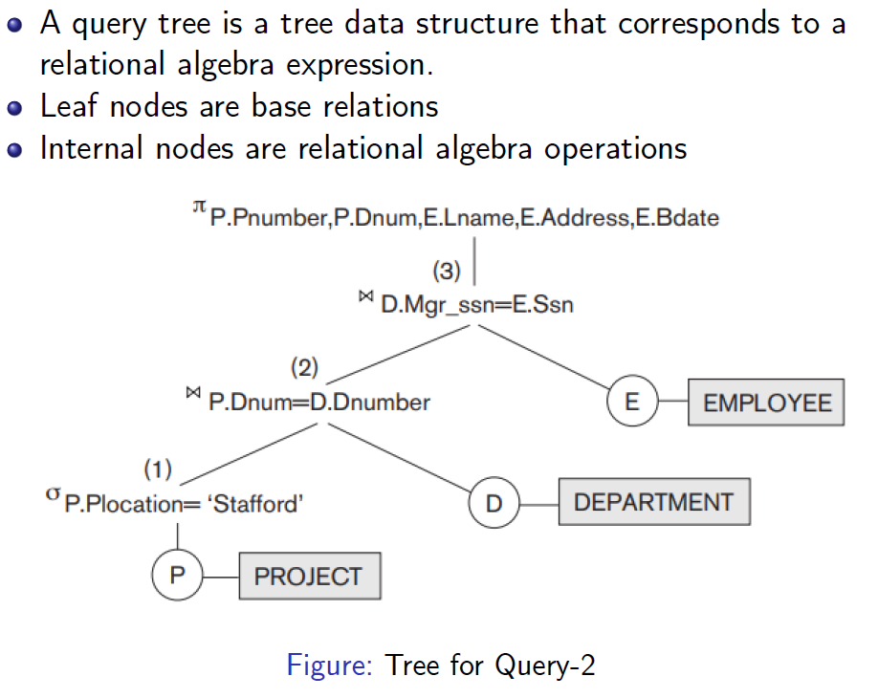

Slide 6
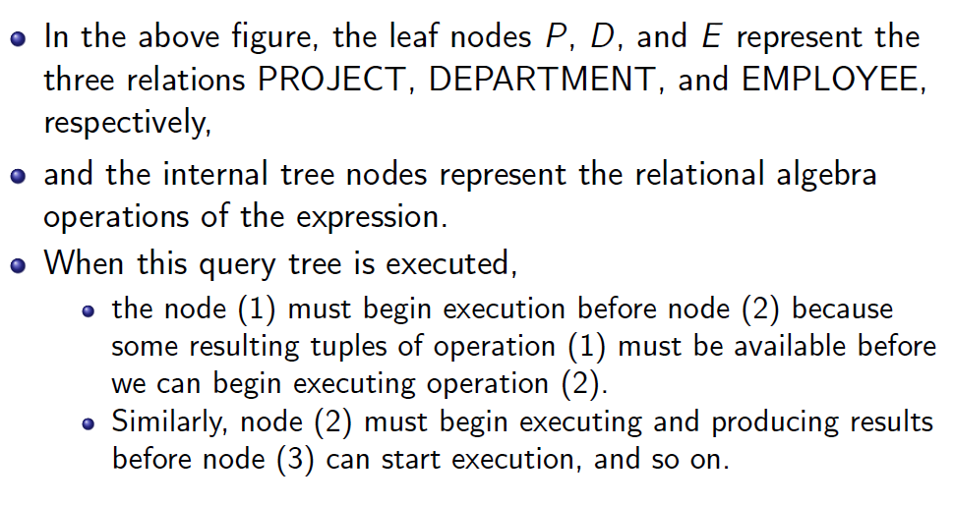

Slide 7
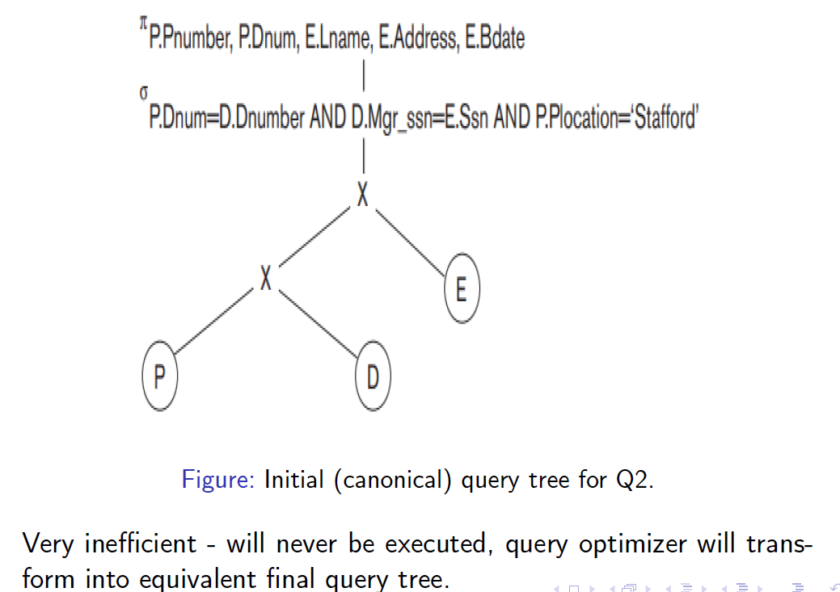
There can be many different relational algebra expressions—and hence many different query trees— that can be generated for the same SQL query.
For example, for a SELECT-PROJECT-JOIN query, the initial tree is shown below.

Slide 8
The CARTESIAN PRODUCT of the relations specified in the FROM clause is first applied; then the selection and join conditions of the WHERE clause are applied, followed by the projection on the SELECT clause attributes.
Such a canonical query tree represents a relational algebra expression that is very inefficient if executed directly, because of the CARTESIAN PRODUCT (×) operations.
For example, if the PROJECT, DEPARTMENT, and EMPLOYEE relations contained 100, 20, and 5,000 tuples, respectively, the result of the CARTESIAN PRODUCT would contain 10 million tuples.
The heuristic query optimizer will transform this initial query tree into an equivalent final query tree that is efficient to execute.

Slide 9
General Transformation Rules for Relational Algebra Operations
Some transformation rules that are useful in query optimization are:
1. Cascade of σ: A conjunctive selection condition can be broken up into a cascade (sequence) of individual σ operations:
σ _{c1 AND c2 AND ... AND cn}(R) = σ_{c1} (σ_{c2} (...(σ_{cn}(R))...) )
2. Commutativity of σ: The σ operation is commutative:
σ_{c1} (σ_{c2}(R)) = σ_{c2} (σ_{c1}(R))
3. Cascade of π: In a cascade (sequence) of π operations, all but the last one can be ignored:
π_{List1} (π_{List2} (...(π_{Listn}(R))...) ) = π_{List1}(R)

Slide 10
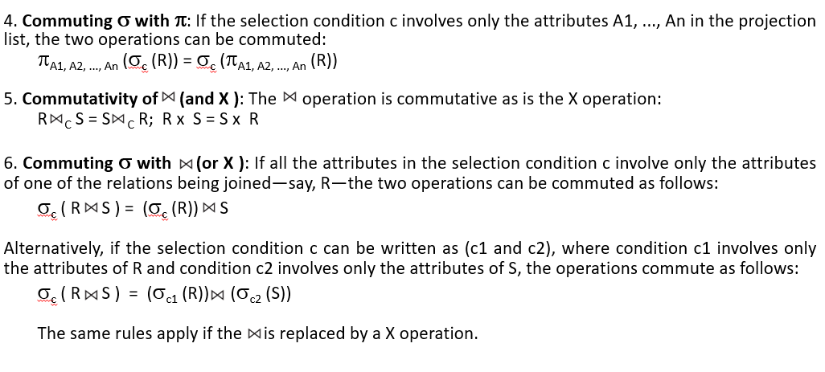

Slide 11
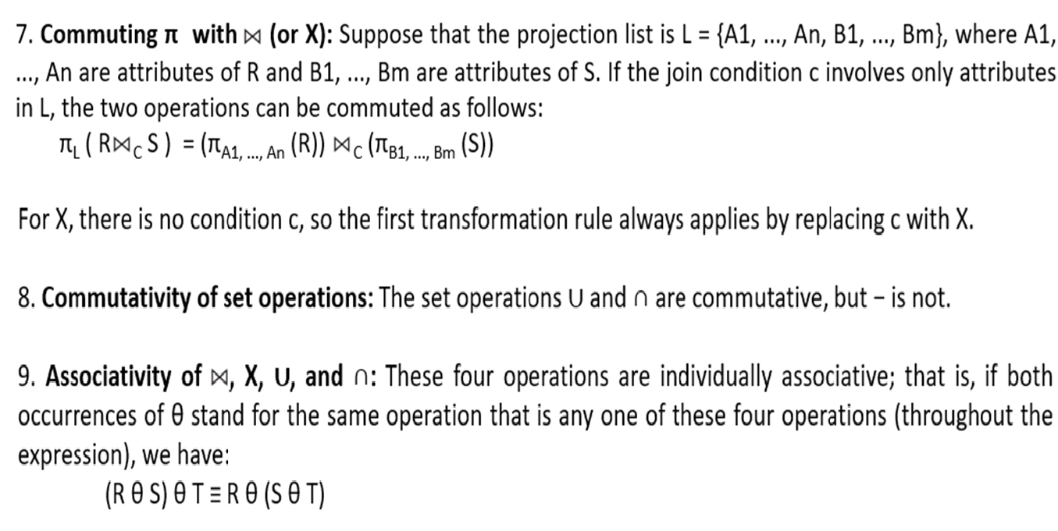

Slide 12
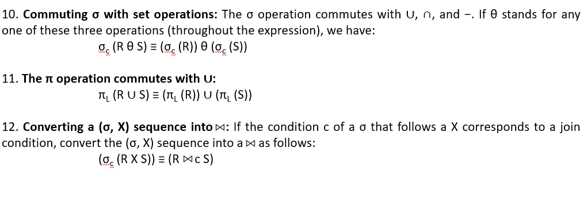

Slide 13
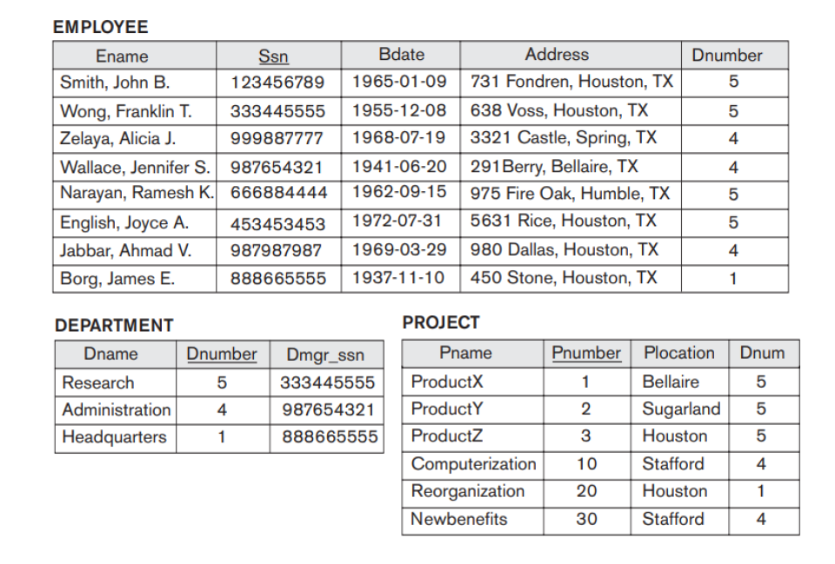

Slide 14
Outline of a Heuristic Algebraic Optimization Algorithm
We can now outline the steps of an algorithm that utilizes some of the above rules to transform an initial query tree into a final tree that is more efficient to execute.
The steps of the algorithm are as follows:
1. Using Rule 1, break up the SELECT operations with conjunctive conditions into a cascade of SELECT operations.
2. Using Rules 2, 4, 6, and 10 concerning the commutativity of SELECT with other operations, move each SELECT operation as far down the query tree as is permitted by the attributes involved in the select condition.

Slide 15
3. Using Rules 5 and 9 concerning commutativity and associativity of binary operations, rearrange the leaf nodes of the tree using the following criteria. Position the leaf node relations with the most restrictive SELECT operations so they are executed first in the query tree representation. Make sure that the ordering of leaf nodes does not cause CARTESIAN PRODUCT operations.
4. Using Rule 12, combine a CARTESIAN PRODUCT operation with a subsequent SELECT operation in the tree into a JOIN operation, if the condition represents a join condition.
5. Using Rules 3, 4, 7, and 11 concerning the cascading of PROJECT and the commuting of PROJECT with other operations, break down and move lists of projection attributes down the tree as far as possible by creating new PROJECT operations as needed.
6. Identify subtrees that represent groups of operations that can be executed by a single algorithm.

Slide 16

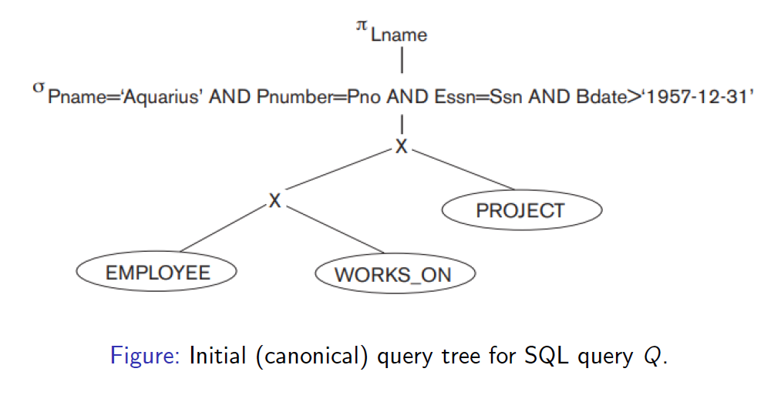
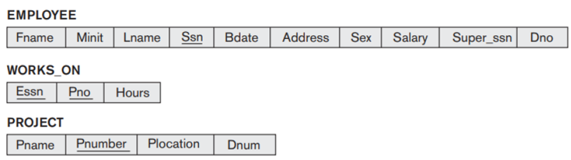

Slide 17
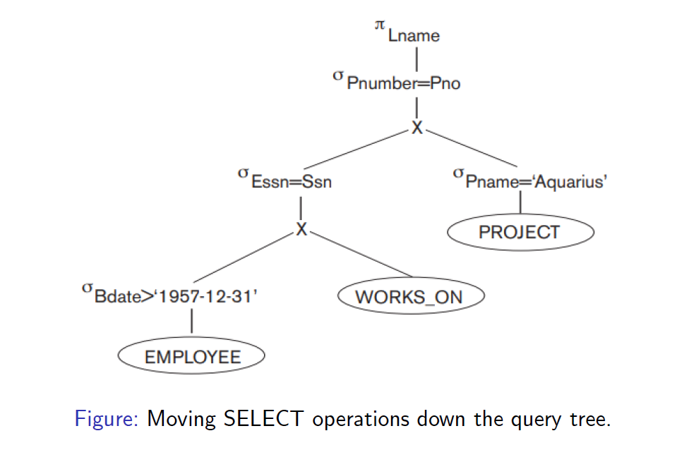

Slide 18
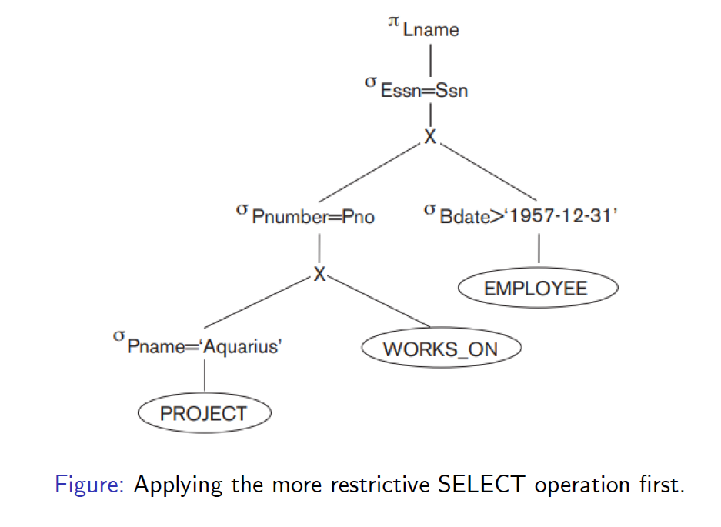

Slide 19
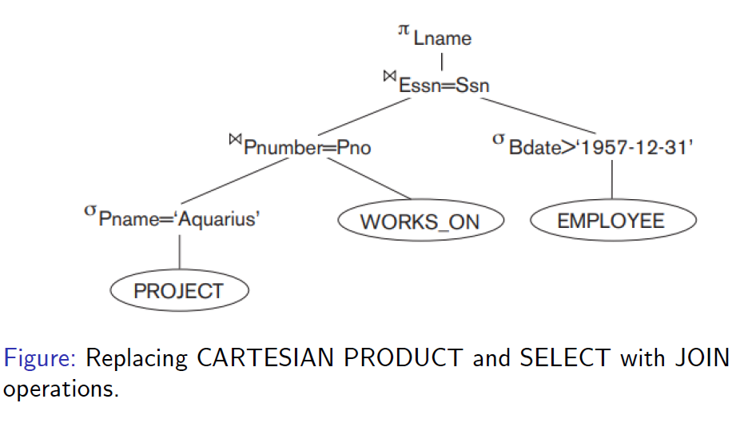

Slide 20
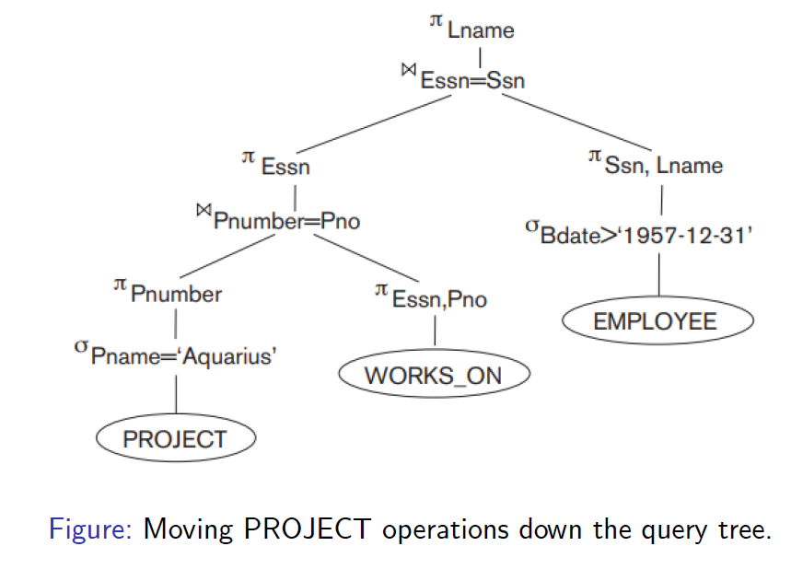

Slide 21
